Slide 1

A STUDY ON ANALYZING AND OPTIMIZING
EMPLOYEE PERFORMANCE USING
MACHINE LEARNING
AND
BUSINESS ANALYTICS
Presented by
SARASWATHI M
MBA [HR & Business analytics ]

Slide 2
CHAPTER - I
INTRODUCTION:
EMPLOYEE PERFORMANCE ANALYSIS:
Employee performance analysis is a data driven approach that evaluates how effectively individuals contribute to organizational goals . This study integrates business analytics, machine learning , business intelligence to assess and predict performance outcomes conducted at united techno, a global IT consulting firm , the research focuses on key factors like resource utilization , leadership ,training effectiveness and employee sentiment.
By applying techniques such as random forest and sentiment analysis the study identifies performance patterns and improvement areas
Visual insights are presented by using power BI dashboards to support HR decisions.

Slide 3
Concepts and definitions:
Employee performance :
Refer to the output quality task completion rate and value addition by an employee to the company
Business analytics (BA):
Use of statistical methods to analyse business data and support decision-making
Machine learning (ML):
Machine learning models like random forest used to predict the future trends and behaviour
Business intelligence(BL):
Tools that help visualize and interpret large data set often through dashboards

Slide 4

Identify training needs
Allocating resources effectively
Eliminating bias from promotions
Increasing motivation and engagement
Create strategic HR policies
NEED FOR PERFORMANCE ANALYSIS:

Slide 5
KEY CONCEPTS IN PERFORMANCE ANALYSIS
Descriptive Analytics: Summarizes historical data to identify high and low performers.
Predictive Analytics: Uses ML models like Random Forest to forecast employee performance
Prescriptive Analytics: Recommends solutions based on predictive insights, such as tailored training and workload adjustments.
Sentiment Analysis: VADER NLP applied to open-ended feedback for classifying as Positive, Neutral, or Negative.

Slide 6
OBJECTIVES OF THE STUDY:
Identify critical factors (training, leadership, work conditions) impacting employee performance.
Measure effectiveness in resource utilization.
Build predictive models for classification and regression.
Visualize insights in Power BI dashboards for actionable intelligence.
SCOPE OF THE STUDY :
The study focuses on how effectively employees at united techno utilize programs the organizational facilities such as training programs ,leadership supports ,learning resources and working conditions and how these inputs influence their performance outcomes it applies advanced analytics and visualization tools to asses the relationship between organizational support and employee contributions across departments .

Slide 7
CHAPTER-II
REVIEW OF LITERATURE:
Hasan, MD Rokibul, et al. “Employee Performance Prediction: An Integrated Approach of Business Analytics and Machine Learning.” Journal of Business and Management Studies, vol. 6, no. 1, Al-Kindi Centre for Research and Development, Feb. 2024
John, Shylu, et al. “An Integrated Approach to Renew Software Contract Using Machine Learning.” Journal of Business Analytics, vol. 4, no. 1, Informa UK Limited, Dec. 2020, pp. 14 25.
Tanasescu, L.G.; Vines, A.; Bologa, A.R.; Vîrgolici, O. Data Analytics for Optimizing and Predicting Employee Performance. Appl. Sci. 2024.
Peter, G.S., Amit, C.B., Deokar, V., Patel, N.R. (2023). Machine Learning for Business Analytics: Concepts, Techniques and Applications in RapidMiner. New York: Wiley

Slide 8

CHAPTER-III
RESEARCH METHODOLOGY
Research design:
Descriptive study :
Understand performance level based on survey responses
Predictive study :
Use machine learning models to forecast future performance
Casual comparative :
ANOVA and Tukey HSD to evaluate departmental differences
Sampling method :
Population : 110 employees at united techno
Sample size : 93 calculated using slovin’s formula
Sampling technique : convenience sampling

Slide 9

Data collection:
Primary data :
Structured questionnaire via google forms
Secondary data :
Academic journals ,research papers
Variables :
Working conditions
Leadership
Career development
Co-workers
Training
Learning
Problem solving
Conflict resolution
Independent variables
Target completion
Engagement &motivation
Quality of work
Individual contribution
Dependent variables

Slide 10
ANALYTICAL TECHNIQUES
Descriptive Statistics: Mean, SD
ANOVA & Tukey HSD: To detect significant differences.
Random Forest (Classifier & Regression): For predictions and department ranking.
K-means Clustering: Employee segmentation.
VADER Sentiment Analysis: Classification of open-ended responses.

Slide 11


Statistical tools used
1.Python environment & Libraries :
Python version 3.13(64-bit)
Python libraries:
NumPy
Pandas
Scikit-learn
Matplotlib
Seaborn
Statsmodels
Factor analyzer
imblearn
2. Power BI –version 2.142

Slide 12

Reliability and validity:
Cronbach Alpha :
0.71 (good reliability)
KMO & Bartlett test :
KMO=0.6569
Bartletts p<0.05 (suitable for factor analysis)
Factor Analysis:
Identified 6 core performance dimensions
Contribution & working condition
Team support &development
Performance & motivation
Learning orientation &leadership
Communicative leadership & career growth
Quality &recognition

Slide 13
CHAPTER-IV
Data analysis and interpretation:
Demographics :
Gender : 54% female , 46% male
Age : 81 % between 18-34 years
Experience : 45% of 1-3 years , 25.7%<1 year
Departments : data analytics (29%), software development(30%), intergration&cloud(29%),HR (12%)
Descriptive findings :
75% fully utilize resources
81% align goals with manager regularly
82% apply training to task
88% collaborate frequently
Average ratings for engagement quality ,contribution all >3.5/4

Slide 14
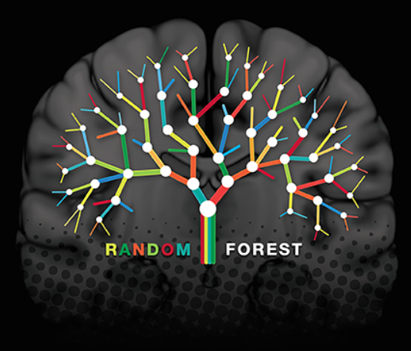
Random forest classifier :
Purpose : to predict the individual contribution level of employees using departmental behavioral data
Input variables: problem solving , learning & development ,conflict, department
Target variable :individual contribution
Method: data was split into training 80%and testing 20% with random oversampler to address class imbalance gridsearchCV was used for hyper parameter optimization
Accuracy :90 %
Key finding :HR department had the highest predicted average contribution dept-wise prediction matched ANOVA results

Slide 15
Department rankings :
ANOVA :
To statistically confirm whether departmental differences in predicted contribution are significant
Result F-statistic =33.7754,p-value=0.0000
Interpretation :
There is a statistically significant difference in performance between departments
Tukey HSD:
To determine which department significantly differ from each other
Findings :
HR significantly outperformed integration and software development ,data analytics and HR had similar performance .integration has lower predicted score
HR
3.833
Data Analytics 3.647
Software Dev 3.224
Integration & Cloud 2.550

Slide 16
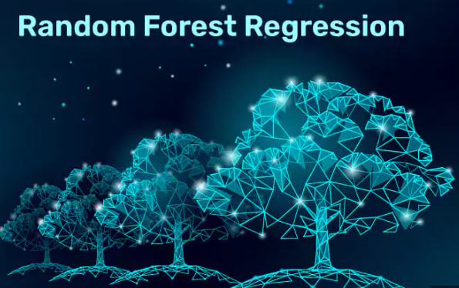
Random forest regression:
Random forest regression was used to predict employees target completion based on factors like working condition, leadership ,training ,learning, co-worker support and career development
The model achieved a high R-square (0.81) indicating that 81 % of the variation in target completion is explained by these variables
Mean squared error (MSE):
Obtained low value indicates that model prediction are close to actual target completion values
Among them training and leadership were identified as the most influential predictors
It shows better training and strong leadership significantly improve employee performance

Slide 17

K-means clustering :
To segment employees into distinct group based on their performance characteristics enabling more personalized analysis and HR interventions
Methodology :
Standardization : all variables were standardized to bring them onto same scale
Elbow method :
Used to determined the optimal number of clusters (k=3 indicating three natural groupings
Cluster interpretation :
Cluster -1: High performance and highly satisfied employees
Strong in leadership training and career development
Cluster-2 : Moderately satisfied employees
Shows gap in leadership quality and development opportunities
Cluster -3
Struggle with conflict management ,quality of work and performance metrics

Slide 18
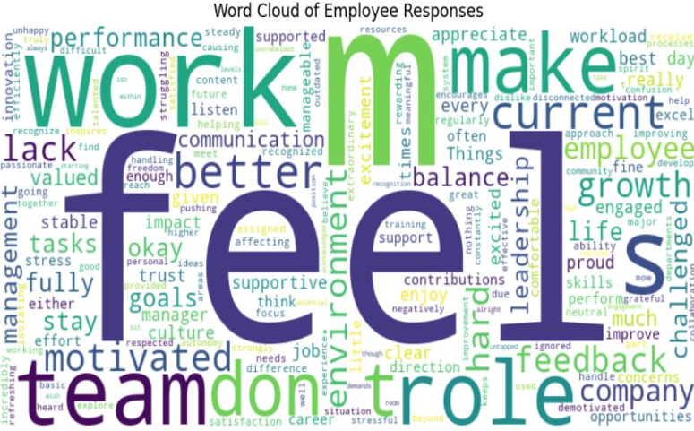
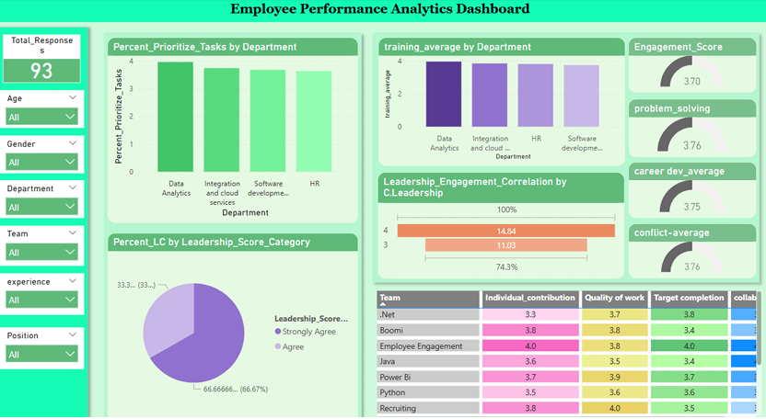
Sentiment Analysis (VADER)
Positive: Leadership and teamwork praised.
Neutral: Objective feedback.
Negative: Stress and workload concerns.
Power BI Dashboard
Slicers: Age, Gender, Department, Experience.
Visuals: Task prioritization, training effectiveness, leadership engagement.

Slide 19
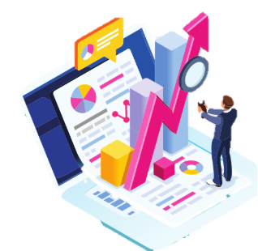
CHAPTER -V
Findings :
Random forest model reveals that training and leadership are the most influential factors contributing to employee target completion
Random forest classifier achieves 90% accuracy in predicting individual employee contribution
With HR department employee showing the highest predicted performance
ANOVA confirms that significant performance difference among departments
Tukey HSD identifies HR and data analytics as leading department
K-means clustering segments employees into three clusters
Sentiment analysis reveals most of the employees express positive experience
Power BI dashboards encourages data-driven performance review rather than subjective judgements

Slide 20

Suggestions :
The company can continue using the power BI dashboard to easily track employee performance and take timely actions
The HR department which is already performing well can support other departments by sharing their leadership and employee engagement methods
The integration team can improve their performance if they get more focused training and regular guidance from the team leaders
Employee who are struggling in cluster 2 can be given special attention and friendly team activities can boost their confidence
The company can also keep updating its training program based on what employees really need in their daily work to maintain healthy work environment

Slide 21

Conclusion :
This study proves that employee performance can be better understood using analytics and machine learning . Training ,leadership and learning are key factors that affect how employees perform
By using tools like random forest ,ANOVA, clustering and power BI company can identify strengths and problems ,supports employees better and make smart HR decisions the approach helps improve both individual performance and over all productivity

Slide 22


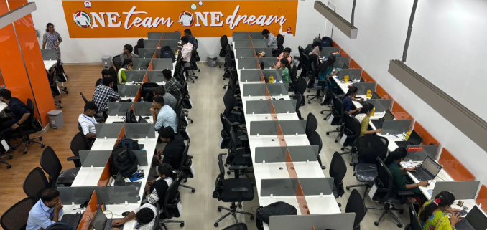

COMPANY PROFILE : UNITED TECHNO INFO SYSTEMS
Established in 2006 ,united techno info systems private limited is a prominent IT services and consulting firm
Services offered:
Application development support
Cloud integration
Consulting services
Pharma compliance solutions
Core values :
Employee centric
Customer success
Global excellence
collaboration

Slide 23

Thank you!

